Slide 1
Optimization

Slide 2
First principle
“The first principle of optimization is
don’t.
    -- Brian W. Kernighan and Rob Pike

Slide 3
Improving Execution Efficiency
Steps to improve execution (time) efficiency:
  (1) Do timing studies
  (2) Identify hot spots
  (3) Use a better algorithm and/or data structure
  (4) Enable compiler speed optimization
  (5) Tune the code

Slide 4
Amdahl’s Law
Total 100s
A 1s
B 99s

Slide 5

Windows: Using VS

Slide 6
Linux: Using GPROF
Step 1: Instrument the program
g++ –pg prog.cpp –o prog
  Adds profiling code to prog
Step 2: Run the program
./prog
  Creates file gmon.out containing statistics
Step 3: Create a report
gprof prog > report
  Uses prog and gmon.out to create textual report
Step 4: Examine the report

Slide 7
Report
Flat profile:
Each sample counts as 0.01 seconds.
% cumulative self self total time seconds seconds calls ms/call ms/call name
61.92 1.67 1.67 5440454 0.00 0.00 laindb::Pager::read(void*, int, int)
12.27 2.00 0.33 5918345 0.00 0.00 laindb::HashMap::get(int)
9.86 2.26 0.27 5918345 0.00 0.00 laindb::Pager::fetch_page(int)
6.69 2.44 0.18 benchmark(int)

Slide 8
Enable compiler speed optimization
g++ prog.cpp –o prog –O2

Slide 9
Tune your code
1 /* Convert string to lowercase: slow */
2 void lower1(char *s)
3 {
4 int i;
5
6 for (i = 0; i < strlen(s); i++)
7 if (s[i] >= ’A’ && s[i] <= ’Z’)
8 s[i] -= (’A’ - ’a’);
9 }
10

Slide 10
11 /* Convert string to lowercase: faster */
12 void lower2(char *s)
13 {
14 int i;
15 int len = strlen(s);
16
17 for (i = 0; i < len; i++)
18 if (s[i] >= ’A’ && s[i] <= ’Z’)
19 s[i] -= (’A’ - ’a’);
20 }
21

Slide 11
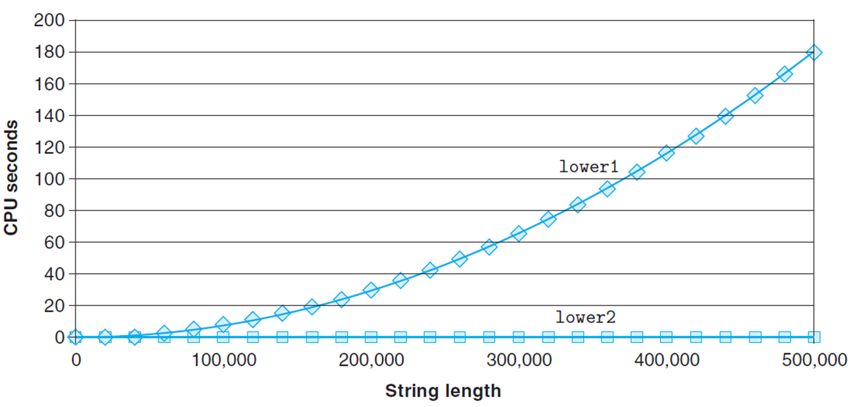

Slide 12
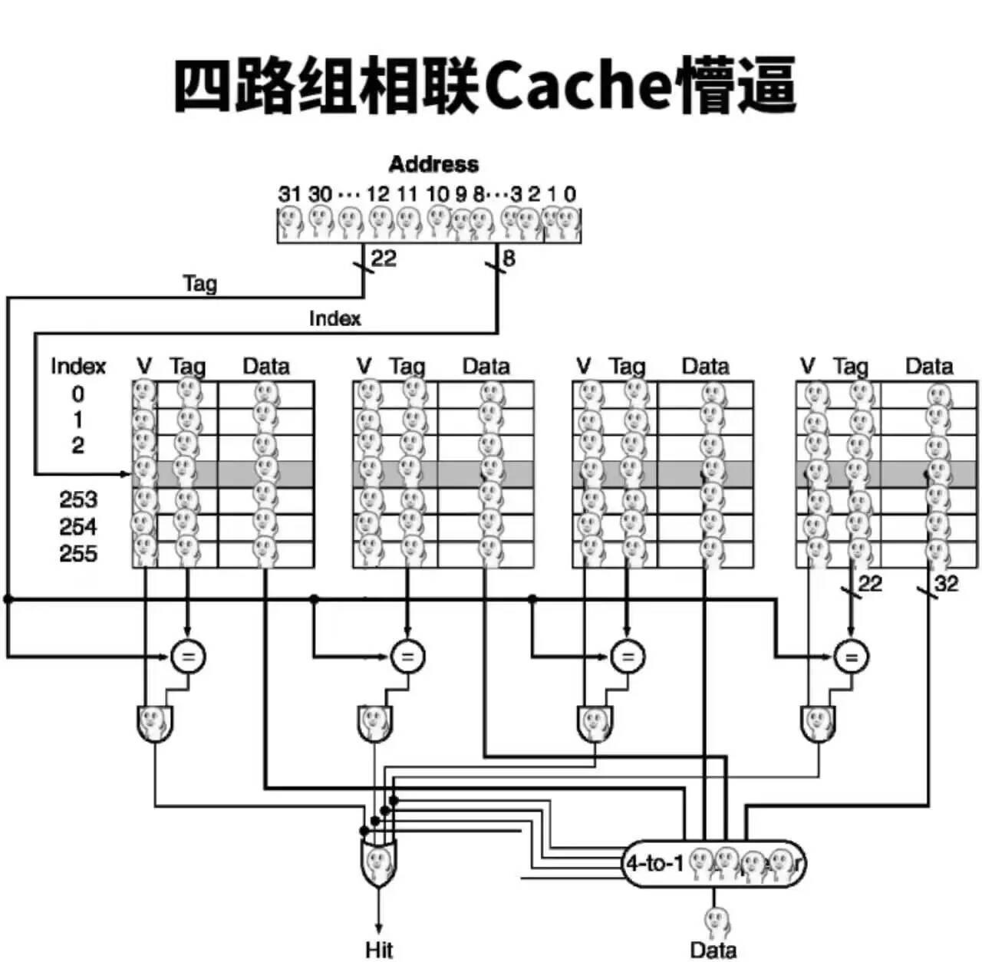
Cache

Slide 13
An example memory hierarchy
Smaller,
faster,
and
costlier
(per byte)
storage
devices
L0:
CPU registers hold words retrieved from cache memory.
registers
L1:
on-chip L1
cache (SRAM)
L1 cache holds cache lines retrieved from the L2 cache.
L2:
off-chip L2
cache (SRAM)
L2 cache holds cache lines retrieved from memory.
main memory
(DRAM)
Main memory holds disk
blocks retrieved from local
disks.
L3:
Larger,
slower,
and
cheaper
(per byte)
storage
devices
L4:
local secondary storage
(local disks)
Local disks hold files retrieved from disks on remote network servers.
L5:
remote secondary storage
(distributed file systems, Web servers)

Slide 14
Locality
(1) 向数据库写nrec条记录。
(2) 通过关键字读回nrec条记录。
(3) 执行下面的循环nrec×5次。s
(a) 随机读一条记录。
(b) 每循环37次，随机删除一条记录。
(c) 每循环11次，随机添加一条记录并读取这条记录。
(d) 每循环17次，随机替换一条记录为新记录。在连续两次替换中，一次用同样大小的记录替换，一次用比以前更长的记录替换。
(4) 将此进程写的所有记录删除。每删除一条记录，随机地寻找10条记录。

Slide 15
Caches
Fundamental idea of a memory hierarchy:
  For each K, the faster, smaller device at level K serves as a cache for the larger, slower device at level K+1.
Why do memory hierarchies work?
  Because of locality, programs tend to access the data at
  level k more often than they access the data at level k+1.
  Thus, the storage at level k+1 can be slower, and thus larger and cheaper per bit.
Big Idea: The memory hierarchy creates a large pool of storage that costs as much as the cheap storage near the bottom, but that serves data to programs at the rate of the fast storage near the top.

Slide 16
General Cache Concepts
Smaller, faster, more expensive
memory caches a subset of
the blocks
Cache
8
4
9
14
10
3
Data is copied in block-sized transfer units
4
10
Larger, slower, cheaper memory
viewed as partitioned into “blocks”
0
1
2
3
4
4
5
6
7
8
9
10
10
11
12
13
14
15

Slide 17
General Cache Concepts: Hit
Request: 14
Data in block b is needed
Cache
Block b is in cache:
Hit!
8
9
14
3
14
0
1
2
3
4
5
6
7
8
9
10
11
12
13
14
15

Slide 18
General Cache Concepts: Miss
Request: 12
Data in block b is needed
Cache
Block b is not in cache:
Miss!
8
9
14
3
12
Block b is fetched from
memory
12
Request: 12
Block b is stored in cache
Placement policy:
determines where b goes
Replacement policy:
determines which block
gets evicted (victim)
0
1
2
3
4
5
6
7
8
9
10
11
12
12
13
14
15

Slide 19
Line Replacement on Misses
LFU (least-frequently-used)
LRU (least-recently-used)s

Slide 20
Issues with Writes
Write hits
  Write through
    Cache updates its copy
    Immediately writes the corresponding cache block to memory
  Write back
    Defers the memory update as long as possible
    Writing the updated block to memory only when it is evicted from the cache
    Maintains a dirty bit for each cache line

Slide 21
Issues with Writes
Write misses
  Write-allocate
    Loads the corresponding memory block into the cache
    Then updates the cache block
  No-write-allocate
    Bypasses the cache
    Writes the word directly to memory
Combination
  Write through, no-write-allocate
  Write back, write-allocate (modern implementation)

